Slide 1

Data Science Presentation Big Mountain Resort
By Evan Nussbaum

Slide 2
What is the problem?
Big Mountain recently installed a new chairlift to increase visitor distribution
The chair increases operating expenses by over 1.5 million dollars
The resort’s strategy is to charge a premium above average market price
The goal is to have a better value for their ticket price
Considering options to cut costs without undermining ticket prices

Slide 3
Recommendations
Of the scenarios given, we recommend going with scenario 3.
Increase Vertical Drop by 150 feet
Requiring the installation of an additional chair lift to bring skiers back up
Add 2 makers of snow making cover
This scenario increases support for ticket price by $11.62 and the expected revenue amount to over 20 million dolalrs

Slide 4

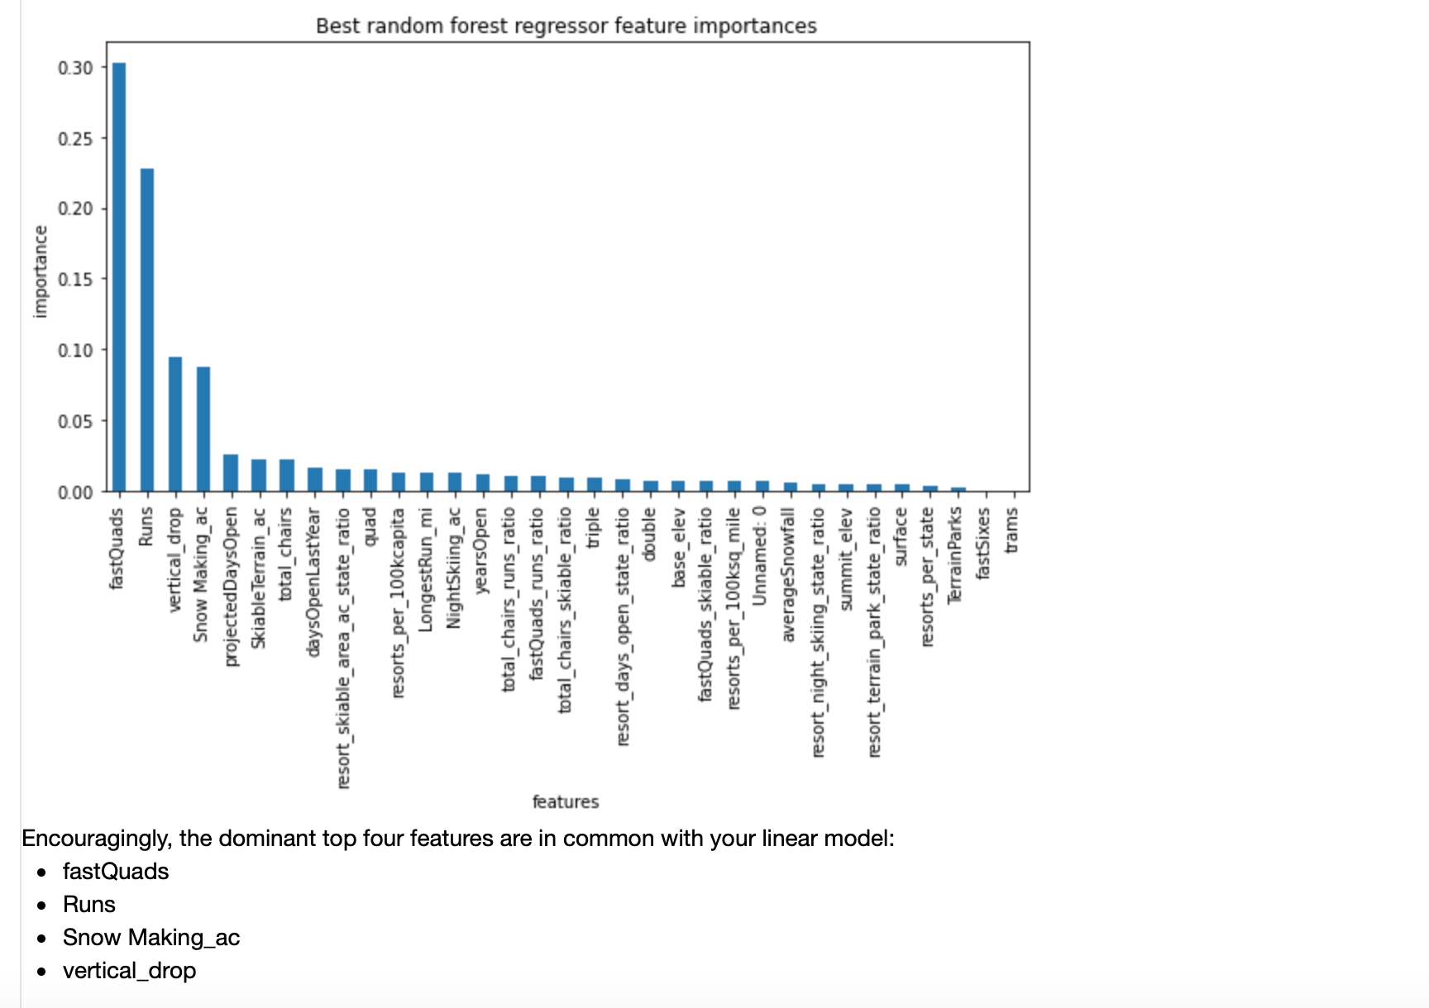
Most important features at Resort

Slide 5
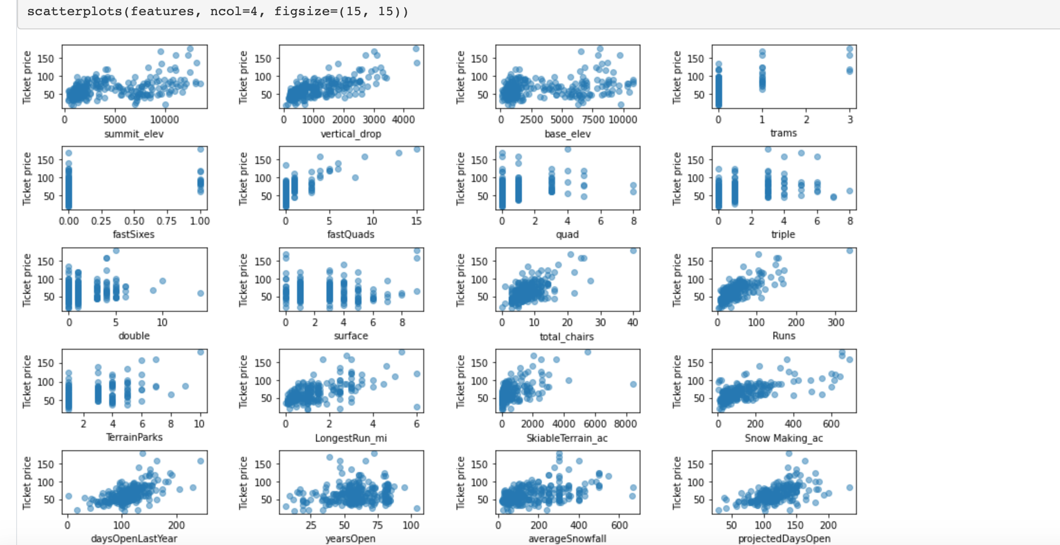
Relationships of Resort Features vs. Ticket Prices

Slide 6
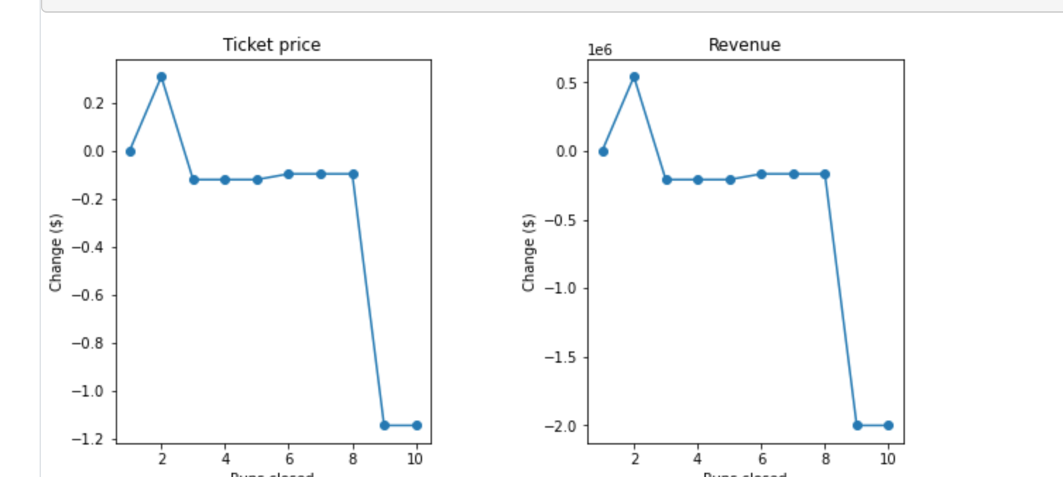
Case Against Scenario 1
. It does not make sense to shut down up to 10 runs because you would lose revenue and cannot really reduce ticket prices until about 8 runs are closed.

Slide 7
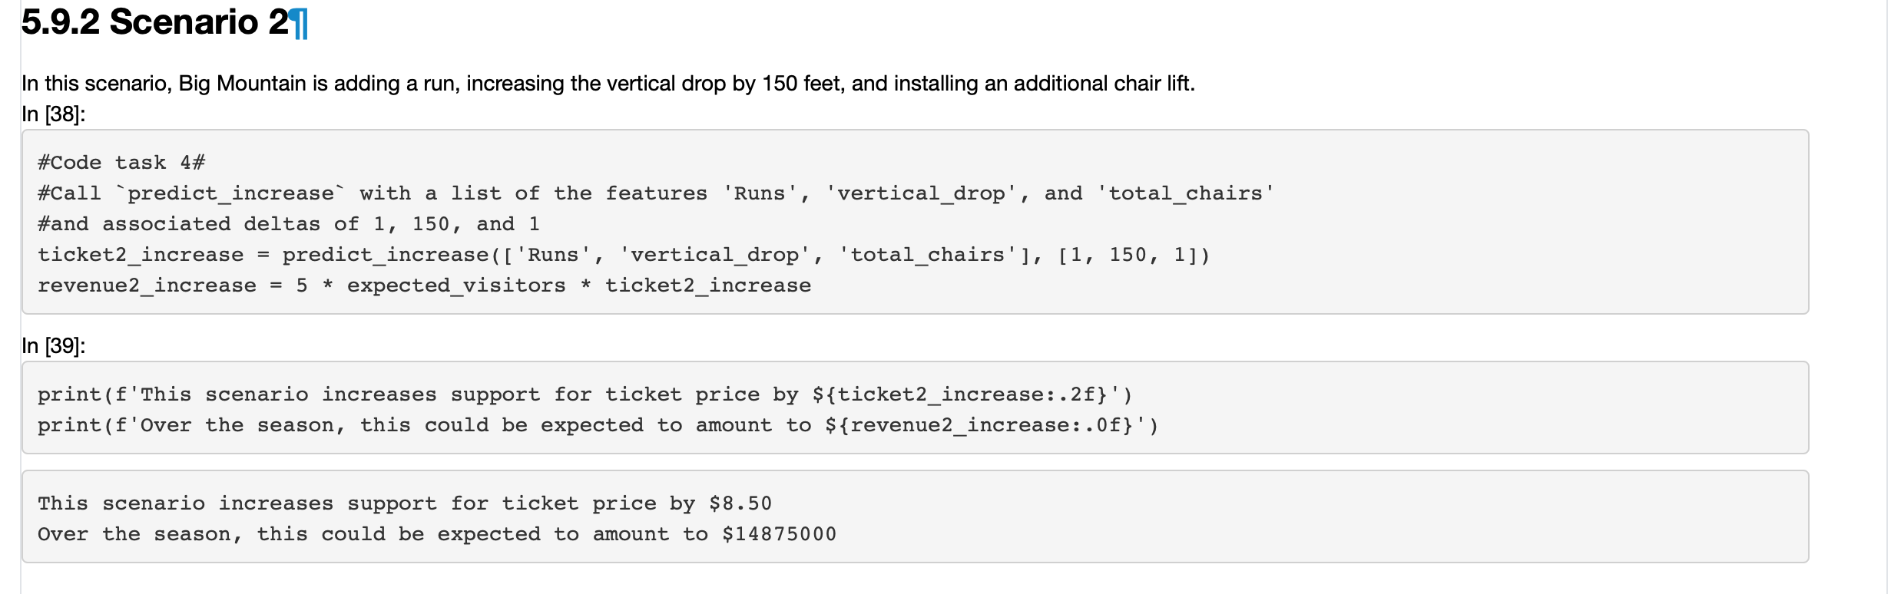
Scenario 2 versus Scenario 3
. Scenario 2 is a good option as well, but it only increases the ticket by 3 dollars less, but revenue is expected at 14 million compared to scenario 3’s 20 million.

Slide 8
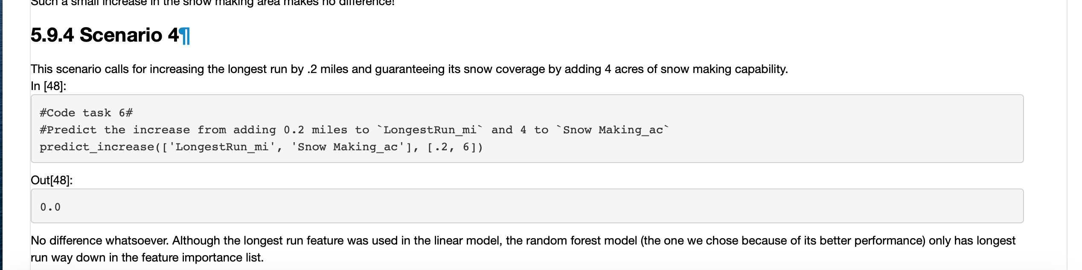
Scenario 4
. Increasing the longest run by .2 miles and adding 4 more acres of snow makes no difference. It it is more of a cost than a benefit to go with this scenario

Slide 9
Conclusion
We recommend going with Scenario 3 as the ticket price increase is so small, but the revenue increase is so large to turn this down.
Ultimately, we feel that such a small increase in the ticket price will not affect people's decision to come down to the resort.
If anything, we feel an additional chair and a longer vertical run will bring a better experience for your customers for years to come.

